Slide 1
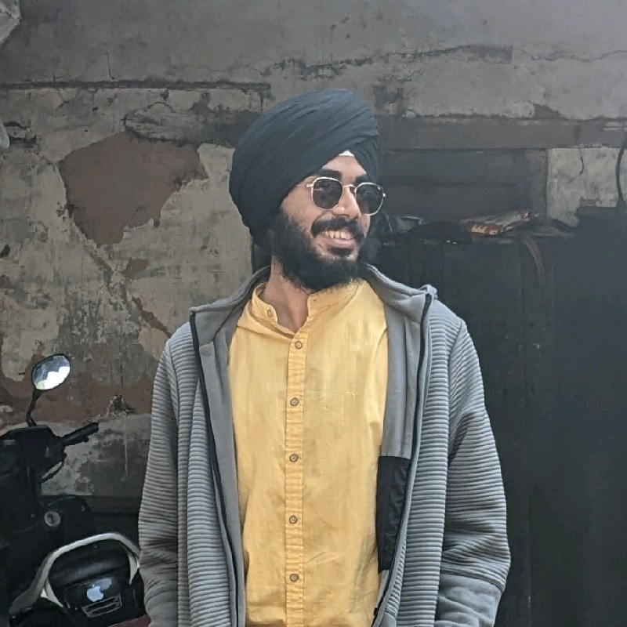
AI - Impact through social media
How ideas, mental health and friendships can be influenced
Agamdeep Singh 20021
BS 3rd Year
Dept of Data Science and Engineering

Slide 2
Can social media make you depressed
Your choice of social media, or rather the Social media developer's choice of a reccomender system, might be affecting your mental health.
A multi-agent simulation that models social media impressions and connections might help

Slide 3
Recommender Systems
Recommender systems are algorithms used to suggest new profiles for you to befriend/follow/connect with on social media.
They work on the basic principle of:
We like to hang out with people similar to us

Slide 4
Mental Health
But when applied to mental health, we attract and get attracted to the people with mental health similar to us? If this were true, that would mean we might have a hard time improving our mental health. As the people we hang out with leave an impression on us. After all,
You are the average of the 5 people you hang out with.

Slide 5
Study Goals
This study aims to find if this is true or not. We are going to study the impact of AI driven social media on our mental health.
We will do this by modelling it as a multi-agent graph simulation.

Slide 6
Hypothesis
Hanging out with depressed people makes you depressed. And hanging out with happy people makes you happy.
Hence, recommender systems that are inherently learning about your mental health and suggesting similar friends and content to you might put you in an unbreakable cycle if your mental health is bad.

Slide 7
Problem Formulation
we represent people with graph nodes.
We use the Networkx library for modelling our graph: https://networkx.org/
Each person has a happiness score **h** which suggest how happy they are currently on a linear scale of 0 to 1.
Each node is labelled as one of: {happy, neutral, sad} depending on their score.

Slide 8
We create 100 nodes(people) where each of their happiness index is drawn from the normal distribution:
N(0.5, 0.1)
and they are assigned a happy/neutral/sad label based on:
0< h < 1/3 -> sad
1/3 < h 2/3 -> neutral
2/3 < h < 1 -> Happy

Slide 9
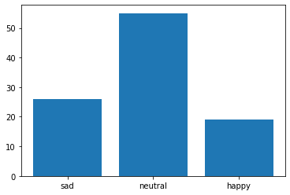
Distribution of happiness scores(100 people)

Slide 10
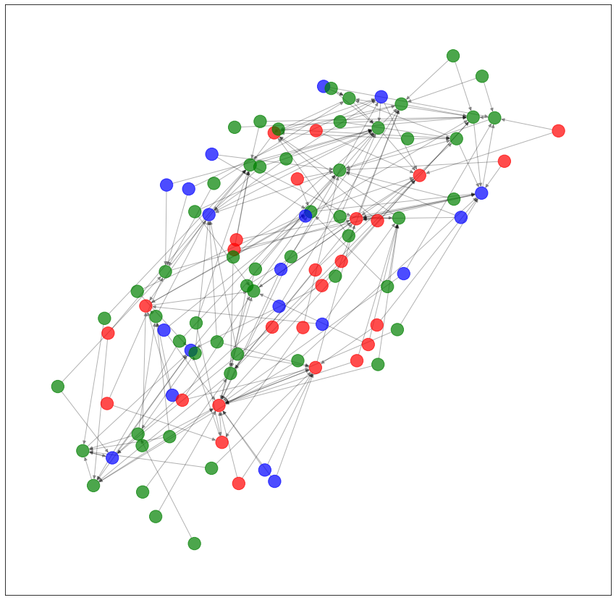
Initial connections
We initially start with each person having 2 friends, randomly chosen from the group

Slide 11
New friends and Impressions
In each iteration, each node makes a new connection.
Since it is more likely to get recommended similar people, the probability of making a friend from a certain class is as follows
let P(X|Y) be the probability of you befriending a node from class X given you are from class Y

Slide 12
sad - S, neutral - N, happy - H
Assume that S is x% more likely to befriend S than N. and x% more likely to befriend N than H. this follows from our similarity assumption
Let P(H|S) be the probability of sad befriending happy
then P(N|S) = (1 + x/100)P(H|S)
P(S|S) = (1 + x/100)P(S|S)
with the additional constraint: P(S|S) + P(H|S) + P(N|S) = 1

Slide 13
for the neutral case:
we have same probability for happy and sad and x% more for neutral

Slide 14
Impressions
In each iteration, a node's current friends all leave an impression on it. let s be the impression strength.
then in each iteration for a node i, for all nodes connected to i
h = s_1 + s_2 + ... + s_k, where s_j is the impression from the jth connected node
impression strength from: happy = +s, neutral = 0, depressed = -s

Slide 15
Simulation
we now conduct a simulation for 10 runs with x=30% and s=0.02

Slide 16
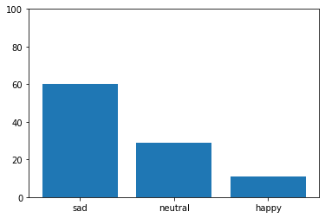
Results

Slide 17
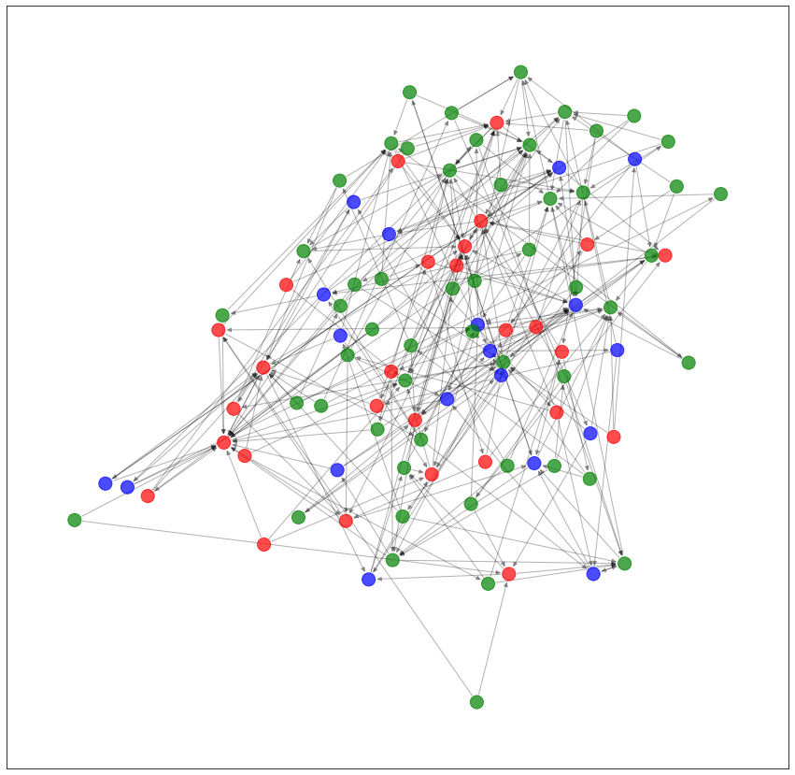
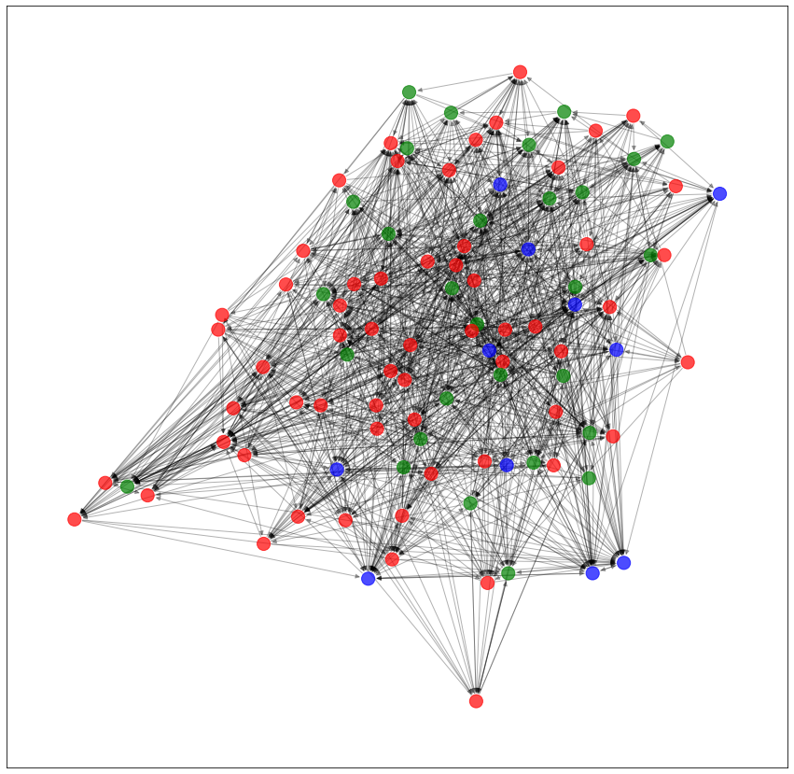

Slide 18
Conclusion
as you can see, the number of neutral and happy people decreased and the number of sad/depressed people increased.
While this is sensitive to initial conditions, on almost all runs, the neutral group gets smaller and the crowd tends to polarise, which might be harmful for our society!

Slide 19
Choose your AI wisely!
so even if you are neutral but on the sadder side, social media recommender systems could make you quite sad.
This result bring out the reality of modern social media and how it is fuelling greater levels of depression among the youth.

